Slide 1

Dial Out Conferencing Application
BY
Ashis Kumar Bhowmik Ahmed Adham Abouzeid

Slide 2
Architecture
Dial out App (Web Client)
REST
REST
REST
Client
Server
REST
JSR309
Media Server
(jVoiceBridge)
Application Server (Sailfin)
Server
Client
SIP Servlet
RTP Sessions
X-Lite Client 1
X-Lite Client 2
X-Lite Client 3

Slide 3
REST Architecture
Conferences Resource
GET
POST
Conference Resource
GET
POST
DELETE
Participant Resource
GET
DELETE

Slide 4
Call Establishment
Web Client
Application Server
User Agent
(Alice)
GET Conferences
Media Server
Response (Conf list)
POST (../create)
Response (conf1@example.com)
POST (../conf1@example.com/addparticiant/(Alice, Bob, Alex))
INVITE (noSDP)
OK (pSDP)
POST (Participant ID, ConfId, pSDP)
POST (Part ID, Confid, msSDP)
ACK (msSDP)

Slide 5
Deleting Conference Removing Participant(s)
Web Client
Application Server
Media Server
Alice
Bob
POST (../conf1../alice/delete)
Alex
POST (../delete/part(alice+conf1))
OK
BYE
OK
POST (../conf1../delete)
POST (../delete/conf(conf1))
OK
BYE
OK
BYE
OK

Slide 6
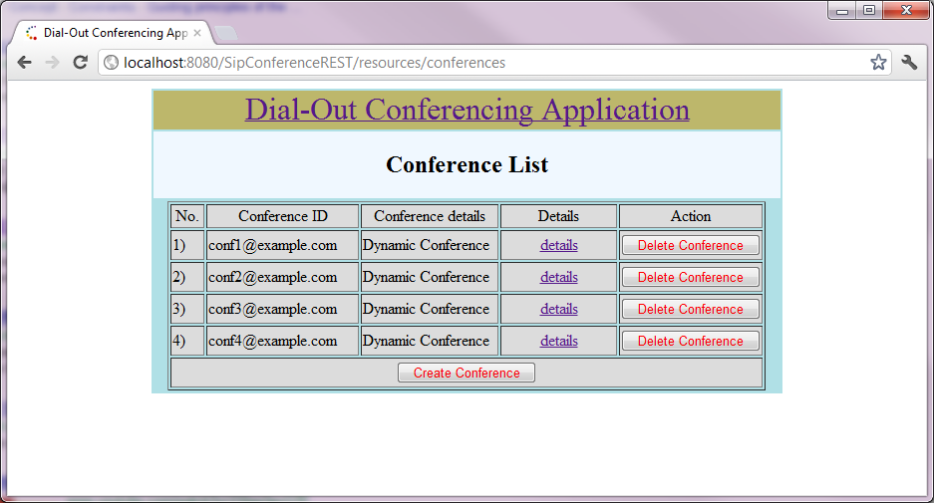
DEMO

